Slide 1


Holidays
Easter time

Slide 2
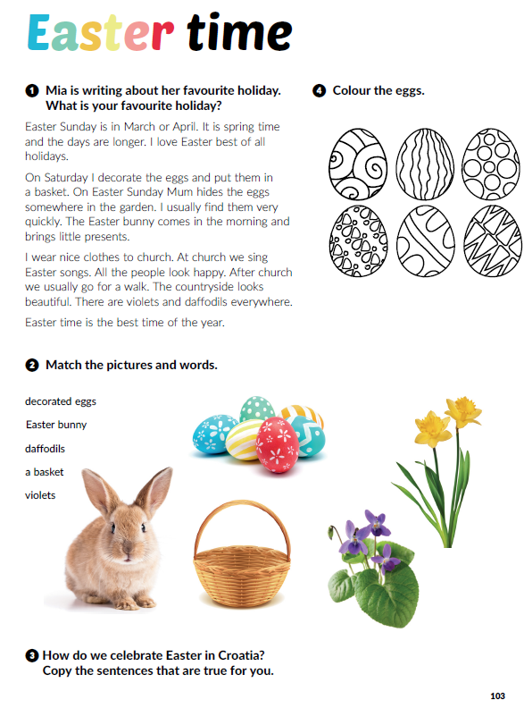
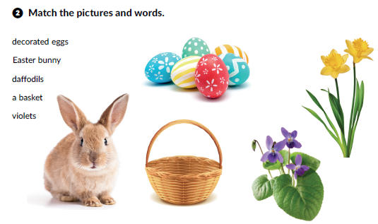
What is your favourite holiday? Why?
Whose favourite holiday is Easter?
What do we celebrate at Easter?
Underline the words connected to Easter in the text.

Slide 3
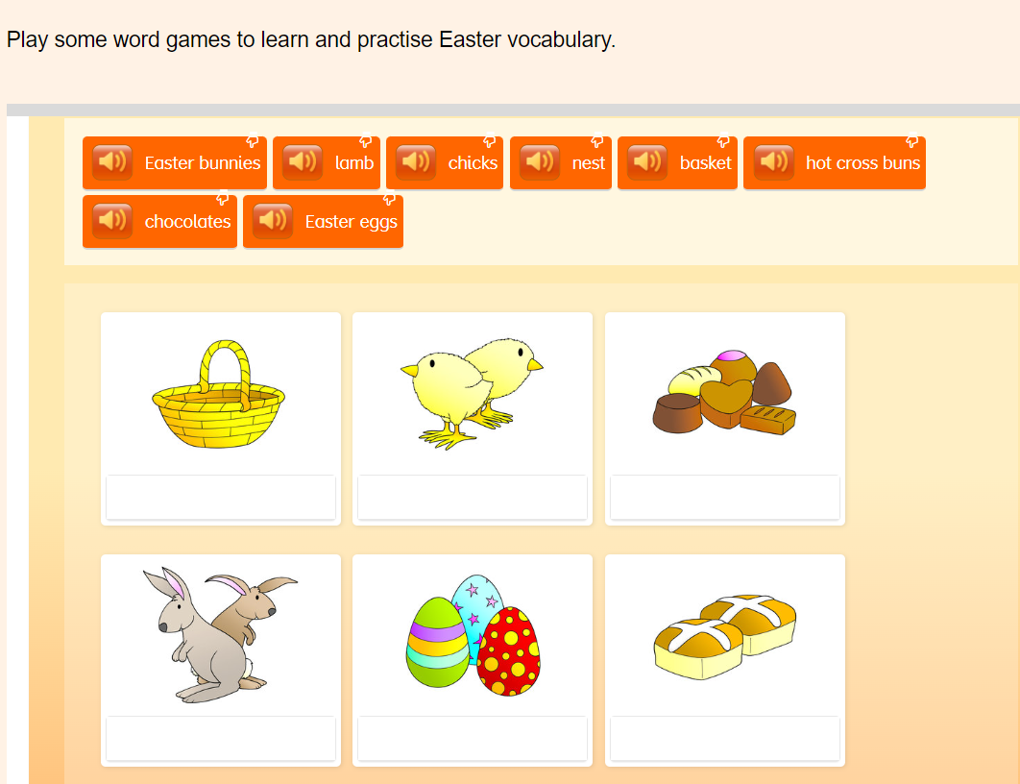
WORD GAME
https://learnenglishkids.britishcouncil.org/word-games/easter

Slide 4
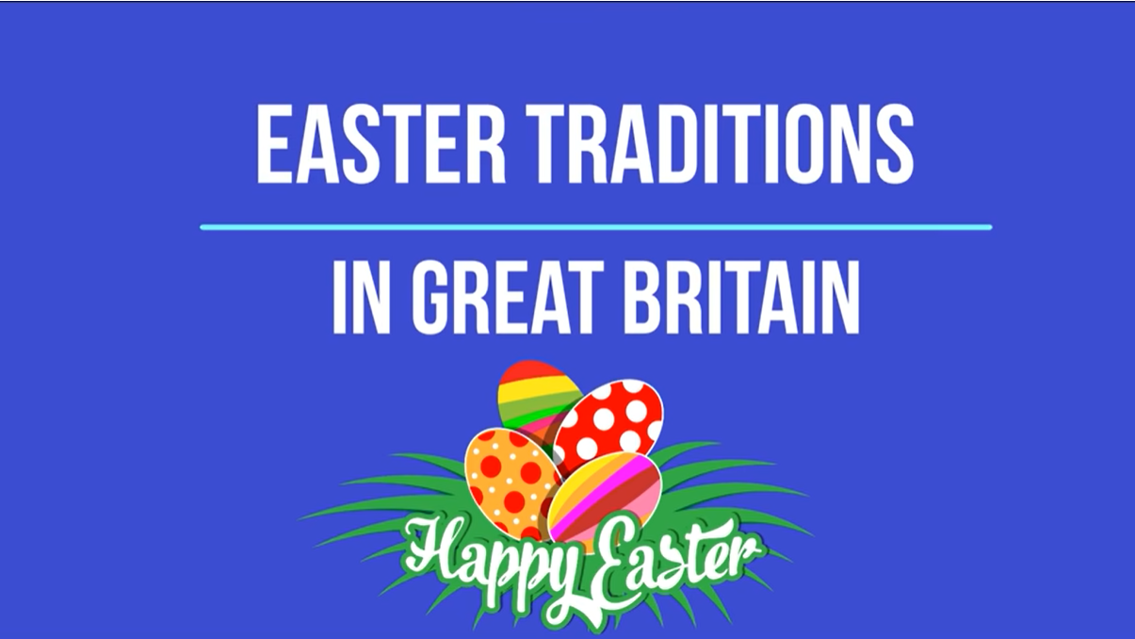
WATCH THE VIDEOS
https://www.youtube.com/watch?v=jD9mR2JinMo&ab_channel=EnglishPortal

Slide 5

